Slide 1
INSTAGRAM USER ANALYTICS
By ~ Laxmidhar Sahoo

Slide 2
Project Description
The marketing team's Instagram projects include rewarding loyal users, encouraging inactive users to post, announcing contest winners, analyzing hashtags, and starting an advertising campaign to expand the platform's user base and engagement.
To achieve these goals, we aim to identify the top 5 hashtags on Instagram, the platform's 5 oldest users, users who have never posted, contest winners based on likes, and the best day of the week to launch an advertising campaign.
Additionally, to assess Instagram's performance, we will provide data on user involvement, such as the average number of posts per user. We will also investigate potential dummy or bot accounts by analyzing users who have liked every single photo, as they may indicate bot or fake activity.
By executing these strategies and analyzing key metrics, we will gauge Instagram's success in reaching its objectives and ensure transparency for our investors.

Slide 3
Approach
My approach to this project is to create a MySQL database from the file and then use data analysis tools to extract insights.
Methods of sorting and filtering will aid in identifying the five oldest users as well as those who have never posted. The typical quantity of postings per user will be determined using statistical techniques.
I will provide my results and recommendations to the marketing team and investors after the analysis is complete. This contains the top five most popular hashtags, the best day to launch an advertising campaign, and information on bot activity as shown by users who have liked each photo.

Slide 4
Tech-Stack Used
MySQL Workbench 8.0 CE (Community Edition) is a versatile visual database design tool with several key advantages:
1. User-Friendly Interface: Its intuitive layout makes it accessible to users of all levels, streamlining database management tasks.
2. Visual Database Design: With Entity-Relationship Diagrams (ERDs), users can design and model databases visually, enhancing understanding and collaboration.
3. Powerful SQL Editor: The integrated editor provides code completion and syntax highlighting, enabling efficient query development and debugging.
4. Data Migration Support: Users can seamlessly migrate data from various database systems to MySQL, simplifying the transition process.
5. Platform Compatibility: Available on Windows, macOS, and Linux, it caters to developers using different operating systems.
6. Open-Source and Free: As an open-source Community Edition, it provides cost-effective access to powerful database management features.

Slide 5

INSIGHTS: MARKETING ANALYSIS

Slide 6
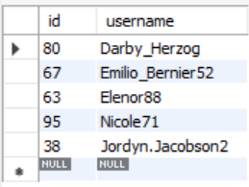
Loyal User Reward
Query:
Output :
SELECT id, username
FROM users
ORDER BY created_at
LIMIT 5;
Suggestion : By rewarding the oldest user it builds a good connection between customer and company also it encourage others.

Slide 7
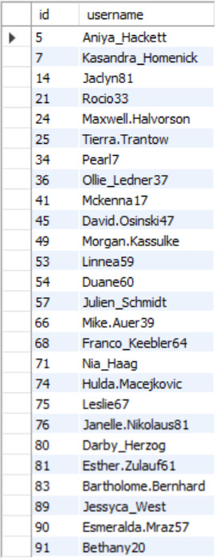
Inactive User Engagement
Query:
Output :
SELECT users.id, users.username
FROM users
LEFT JOIN photos ON users.id = photos.user_id
WHERE photos.user_id IS NULL;
Suggestion : Promote the Inactive user by creating contests and rewarding prizes. Also notify them everyday to post on instagram.

Slide 8
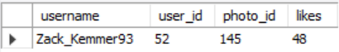
Contest Winner Declaration
Query:
Output :
SELECT username, p.user_id, photo_id, COUNT(l.user_id) AS likes
FROM likes l
INNER JOIN photos p ON l.photo_id = p.id
INNER JOIN users u ON p.user_id = u.id
GROUP BY photo_id
ORDER BY likes DESC
LIMIT 1;
Suggestion : Promote the contest winners by shout out their names and rewarding them gifts and prizes, it encourage the winner and motivate other users also.

Slide 9
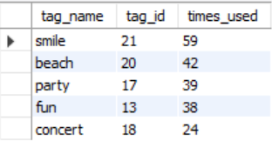
Hashtag Research
Query:
Output :
SELECT tag_name, tag_id, COUNT(tag_id) AS times_used
FROM photo_tags pt
INNER JOIN tags t ON pt.tag_id = t.id
GROUP BY tag_id
ORDER BY times_used DESC
LIMIT 5;
Suggestion : Collaborating with brands can generate higher revenue. By putting these tags brands can reach out millions of people on Instagram and advertise their products.

Slide 10
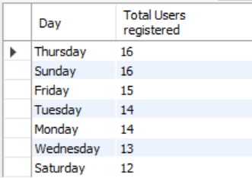
Ad Campaign Launch
Query:
Output :
SELECT DAYNAME(created_at) AS Day, COUNT(id) AS `Total Users registered`
FROM users
GROUP BY DAYNAME(created_at)
ORDER BY `Total Users registered` DESC;
Suggestion : As per data Thursday and Sunday are the best day to launch Ad campaign. Also I recomandate to create and post of Ads and promote it through top Celebrities and by using top hashtags.

Slide 11

INSIGHTS: INVESTOR METRICS

Slide 12
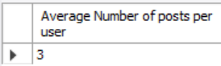
User Engagement : Average number of posts per user
Query:
Output :
SELECT ROUND(AVG(count)) AS `Average Number of posts per user`
FROM (
SELECT user_id, COUNT(id) AS count
FROM photos
GROUP BY user_id
) AS Average;
Suggestion : Considering the average number of posts per user in conjunction with other key metrics, such as user growth, revenue, and retention rates. Analyzing these metrics collectively helps company assess the platform's overall health, potential for growth, and long-term sustainability.

Slide 13
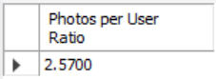
User Engagement : Total number of photos on Instagram divided by the total number of users
Query:
Output :
SELECT COUNT(id) / (SELECT COUNT(id) FROM users)
AS `Photos per User Ratio`
FROM photos;
Suggestion : It provides valuable insights into the platform's health, attractiveness to users and advertisers, and its overall growth trajectory, helping investors make informed decisions about their investments in the platform.

Slide 14
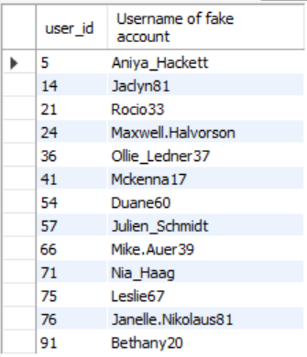
Bots & Fake Accounts
Query:
Output :
SELECT u.id AS user_id, u.username AS `Username of fake account`
FROM users u
INNER JOIN (
SELECT user_id, COUNT(DISTINCT photo_id) AS total_photos_liked
FROM likes
GROUP BY user_id
HAVING total_photos_liked = (SELECT COUNT(id) FROM photos)
) AS potential_bots ON u.id = potential_bots.user_id;
Suggestion : Bots and fake accounts pose significant challenges to Instagram's authenticity, user experience, and advertising ecosystem. By removing those accounts it makes better user experience.

Slide 15
Result :
This project help me in :
1. Acquiring Proficiency in Data Analysis Techniques: I have honed my skills in various data analysis techniques and methods, enabling me to effectively extract valuable insights and information from the data.
2. Formulating Recommendations Based on Data Analysis: Through this project, I have gained experience in making well-founded recommendations by interpreting and applying the insights obtained from data analysis.
I am confident that the experience and knowledge gained from this project will prove advantageous in my future endeavors involving data analysis and the formulation of recommendations. This project has provided me with a deeper understanding of how to analyze data and draw meaningful insights, a skill that holds immense value across diverse industries and fields.

Slide 16
Thank You

